Slide 1
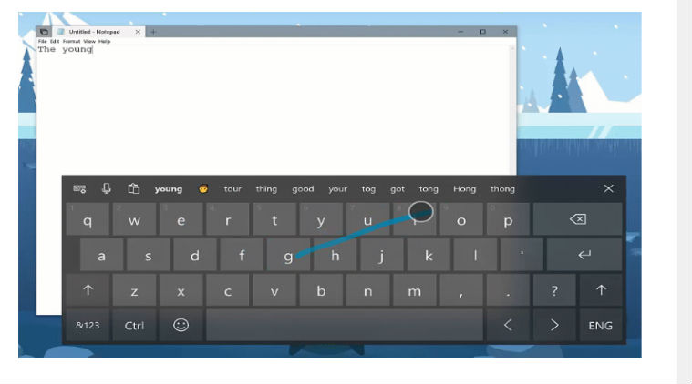
Virtual Keyboard for Quadriplegia Patients

Slide 2

Team Vision:
Mostafa Didar Mahdi
Sazid Al Emon
Arnab Rezvy
Muhtadi Akif
Tanvir Azad

Slide 3
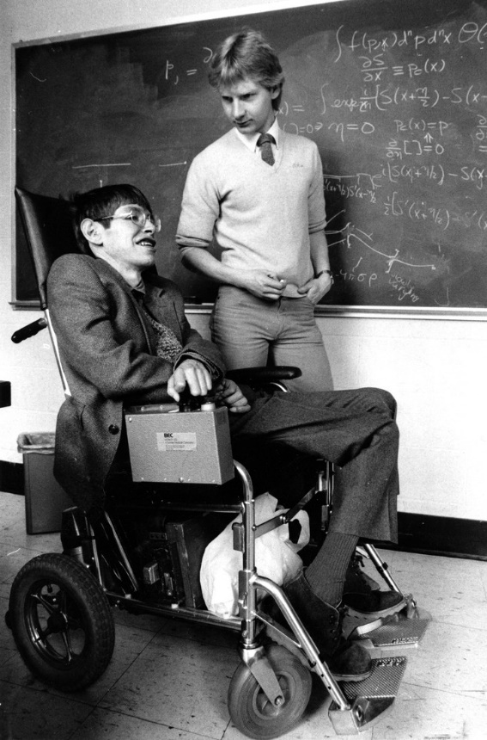
Project Goal: Quadriplegic Patient Support System

Slide 4
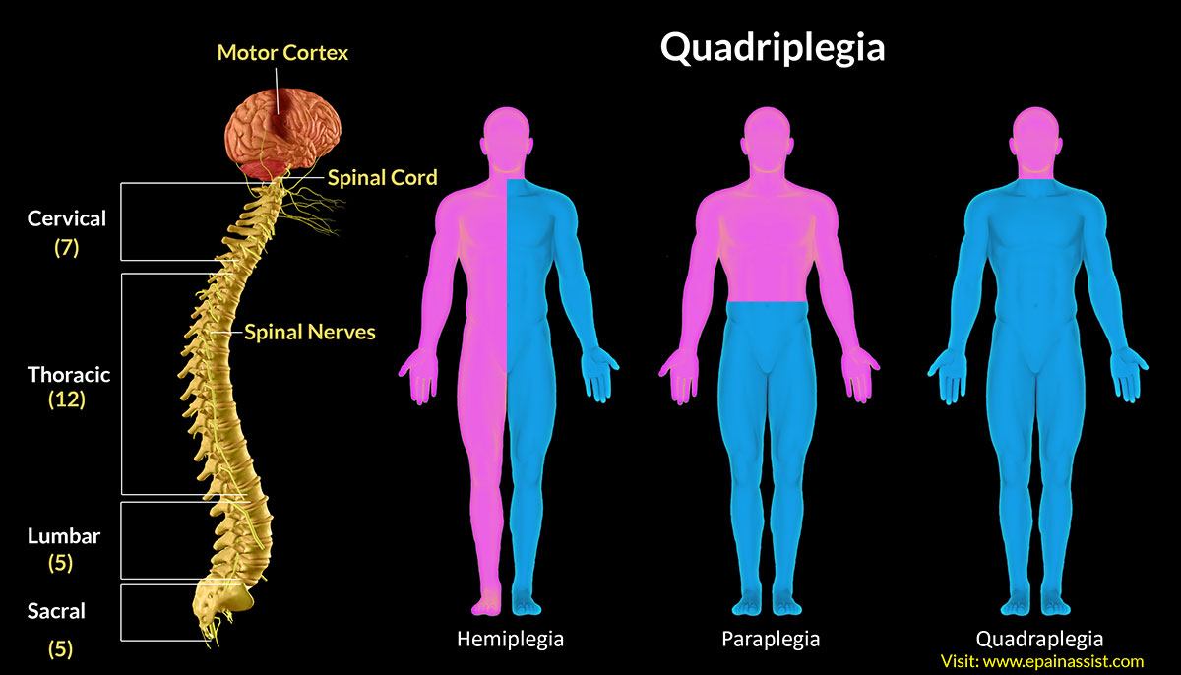
What is Quadriplegia?
Quadriplegia, also known as Tetraplegia, is defined as paralysis caused by illness or injury to a human that results in the partial or total loss of use of all their limbs and torso.

Slide 5
Proposed Solution:
Part 1:
Face and Eye Detection
Part 2:
Virtual Keyboard
Part 3:
Integration of Part 1 and 2

Slide 6
Proposed Framework:
Face
Detection
Extract Features
Eye Detection (Pupil)
Training Weights
Virtual Keyboard Design
Integrating Eye Movement with Keyboard
Adding Sound
Adding Text box
Testing
Calibrating

Slide 7
Dependencies and Framework used:
OpenCV
Dlib
Pyglet
Numpy
Python math and time libraries

Slide 8
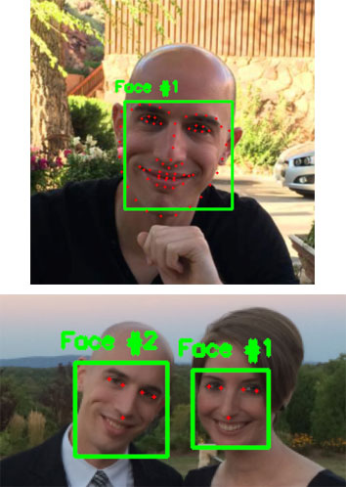
Methodology:
Facial Landmark detection using Dlib

Slide 9
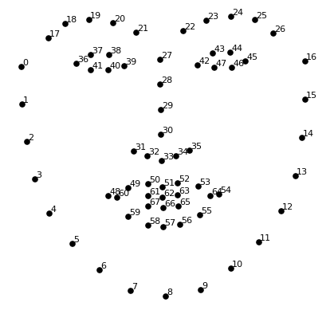
Dlib:
Uses HOG (Histogram of Oriented Gradients) + Linear SVM detector to detect faces in the grayscale image.
HOG descriptor is computed by calculating image gradients that capture contour and silhouette information of grayscale images.
Images are turned to Gray Scale to save computation power.

Slide 10
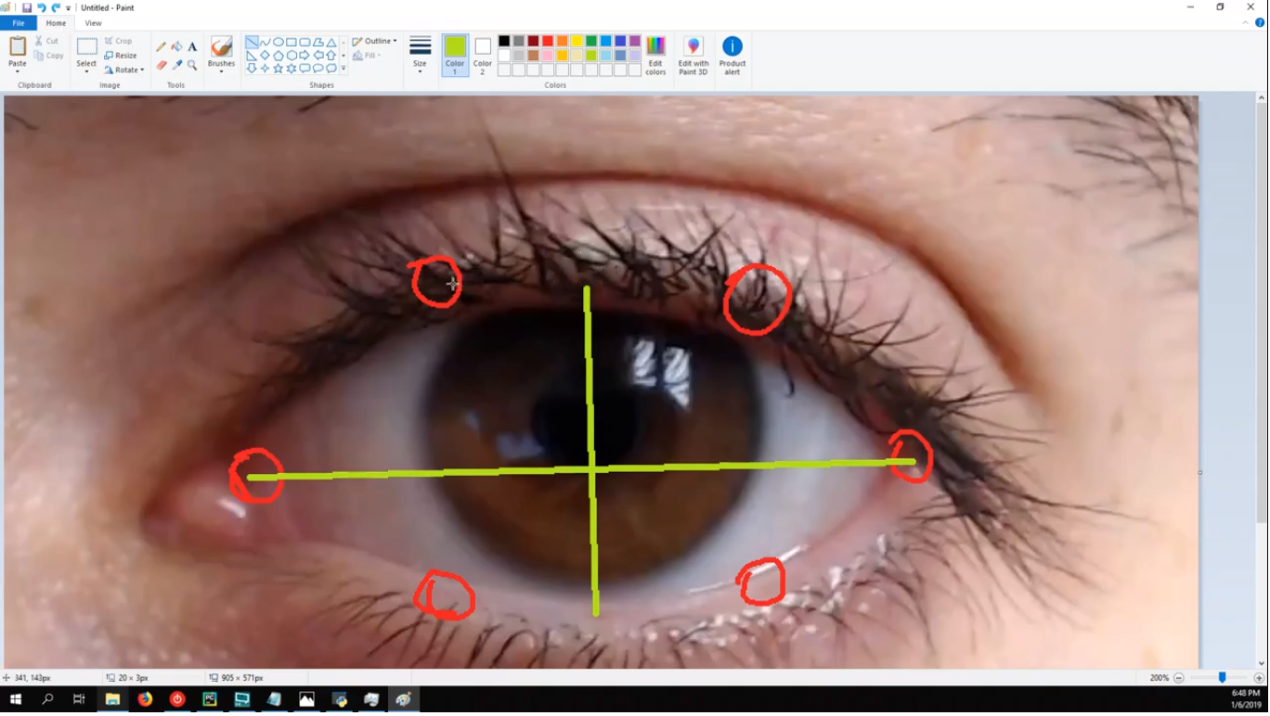
Feature Extraction: Eyeball detection using Open CV - Haar Cascade Classifier
Labeling images

Slide 11
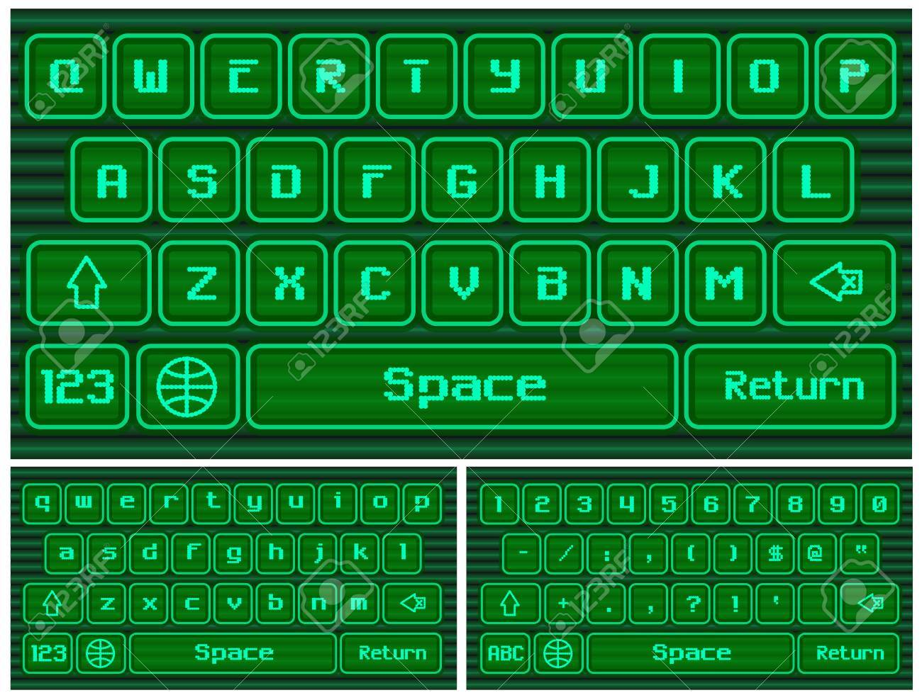
Virtual Keyboard and sounds using Pyglet
pyglet is a cross-platform windowing and multimedia library for Python, intended for developing games and other visually rich applications. It supports windowing, user interface event handling, Joysticks, OpenGL graphics, loading images and videos, and playing sounds and music.

Slide 12
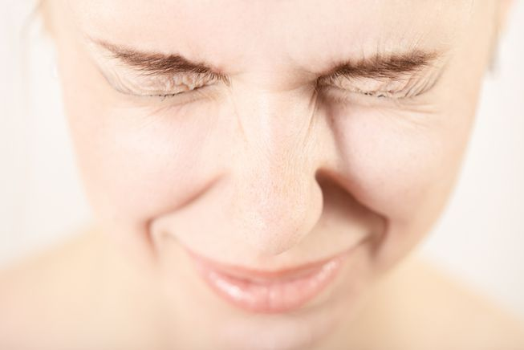
Final Result
Patient moves pupil in the direction he wants to move in the keyboard
Patient blinks to select letters from the keyboard onto a notepad and convey messages

Slide 13
References:
https://docs.opencv.org/3.4.3/d7/d8b/tutorial_py_face_detection.html
https://www.learnopencv.com/facemark-facial-landmark-detection-using-opencv/
https://www.pyimagesearch.com/2018/04/02/faster-facial-landmark-detector-with-dlib/
https://towardsdatascience.com/cnn-based-face-detector-from-dlib-c3696195e01c
https://bitbucket.org/pyglet/pyglet/wiki/Home
https://medium.com/the-downlinq/histogram-of-oriented-gradients-hog-heading-classification-a92d1cf5b3cc

